Slide 1

Venture Vista
Explore Investment with clarity

Slide 2

Why VentureVista
Analyzed the provided data.
Recognized the complexity and fragmentation in the investment process.
Brainstormed potential solution or ideas to address the challenge.

Slide 3
Key Features
Comprehensive Company Profiles.
Investor Interaction.
User-Centric Experience.
Robust Data Management.
Notes:
Detailed profiles allowing companies to showcase background, offerings, and financial data.
Direct interaction between investors and companies, enabling investors to pitch investment proposals and companies to review and approve them.
Tailored experiences for both company personnel and investors, ensuring intuitive navigation and functionality.
enhanced performance and scalability while ensuring seamless data management.

Slide 4





Approach
Understanding Data.
Frontend Design.
CRUD Operations.
Error Handling.
Deployment.

Slide 5
Frontend
React : Offers a component-based approach for efficient development
Tailwind CSS : Enables rapid development of custom designs
Syncfusion : Specializes in charts for interactive data visualizations

Slide 6
Backend
Node.js with Express framework.
Clean Architecture: Organized into feature-specific folders. Enhances maintainability and scalability of the codebase
Database Management: CQRS (Command Query Responsibility Segregation) pattern followed for CRUD operations

Slide 7
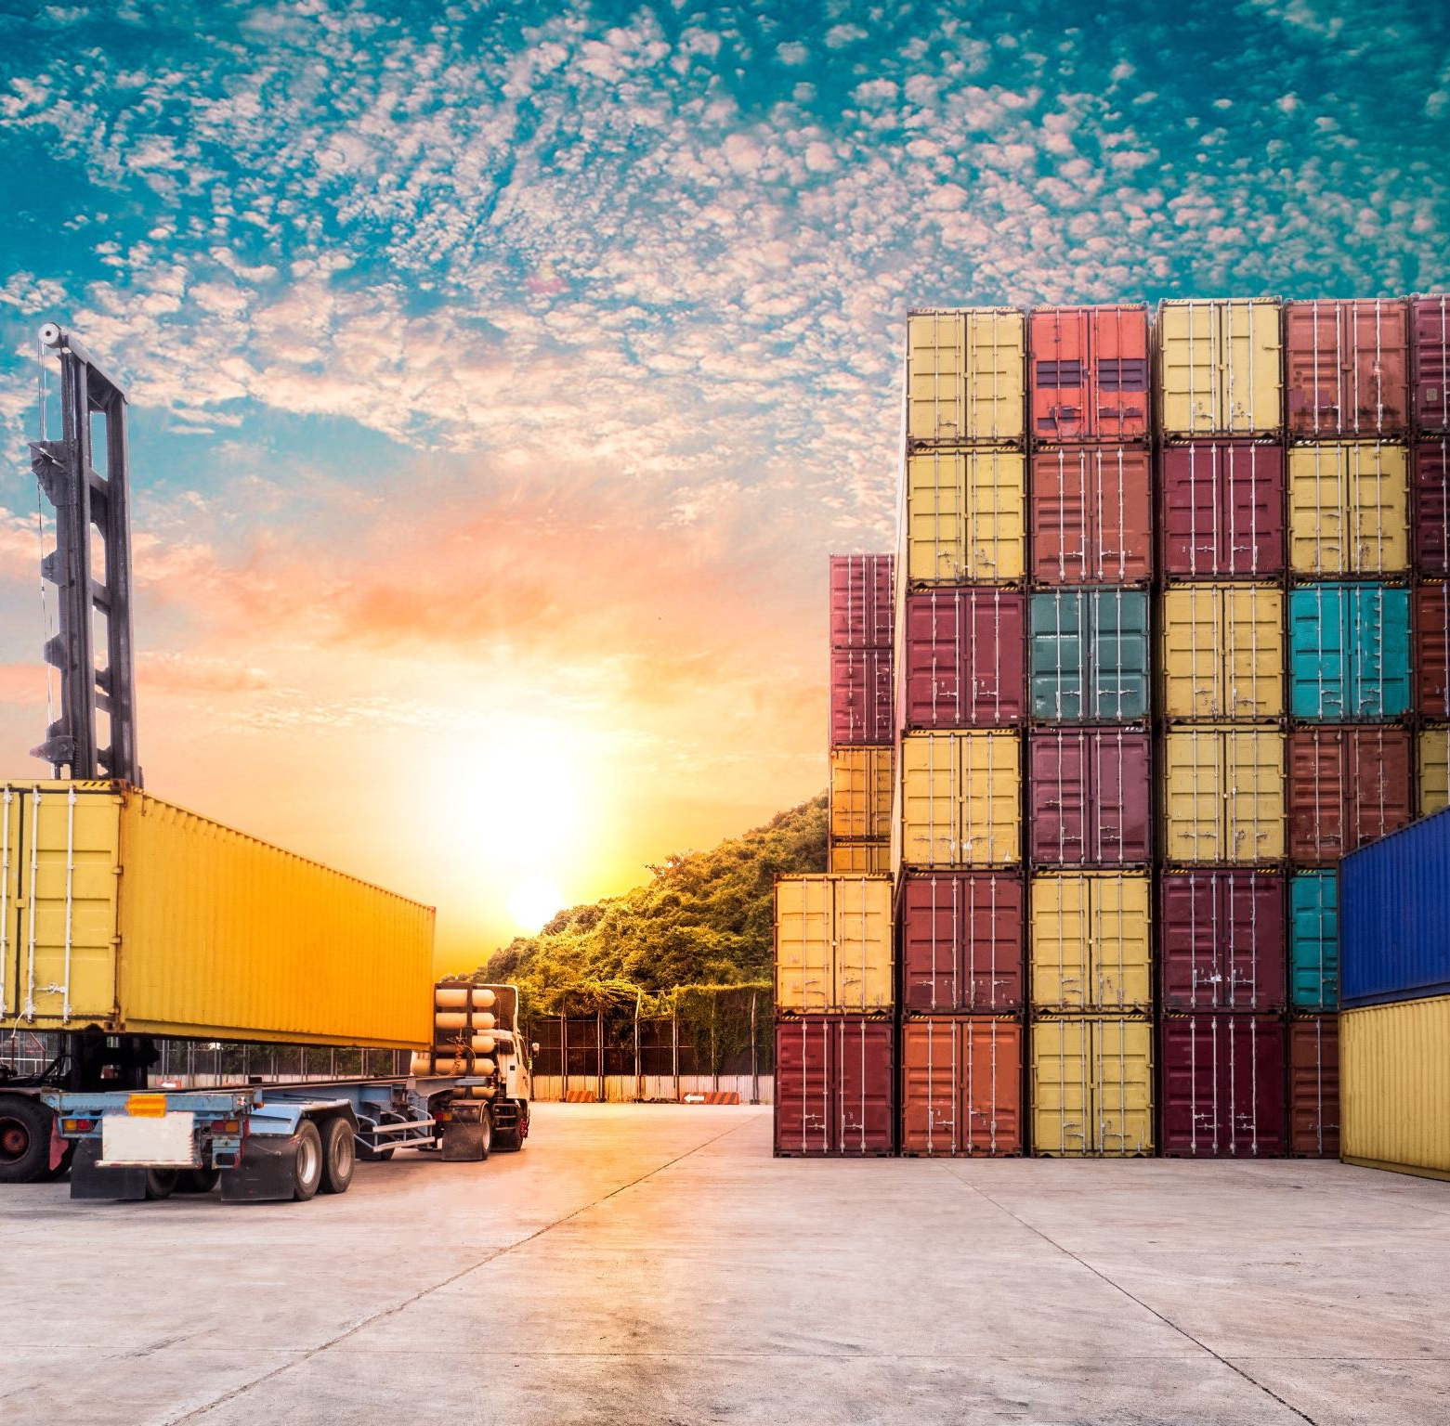
Deployment
Containerization with Docker
Facilitates easier deployment and management across various environments.
Kubernetes Compatibility
Docker images generated can be utilized within Kubernetes pods
Kubernetes Deployment in cloud environments like Amazon EKS (Elastic Kubernetes Service) on AWS.

Slide 8

DEMO

Slide 9

Monthly Strategic Agenda
Week 1: Onboarding of Customers and Setting Up Infrastructure and Environment
Week 2: Search, Portfolio Page & Mail Feature
Week 3: Develop a search recommendation system, model for predicting future growth
Week 4: Integrating Models with Backend and Frontend

Slide 10

Thank you

